Slide 1
Cyber Security Operations Center (CSOC) Project
Building a Prototype and Production Infrastructure for SMEs
Team Members: Archie, Amber, Anthony, Flynn, Michael

Slide 2
Project Overview
Goal
Step 1
Step 2
Step 3
Our objective: to develop a prototype cybersecurity model (CSOC) from SMEs.
Components: both physical and virtualized firewalls, servers, clients and Elastic security SIEM
Components: integrate the physical and virtual security components like firewalls, servers and clients
The overall goal is to develop a prototype and production of Cyber Security Operations center infrastructure for a small to medium sized enterprise
Anthony

Slide 3

Project Initiation
Formed Team: Assembled into a group and assigned roles based on strengths and weaknesses
- Amber (Project Manager) - Anthony (Financial and Research Coordinator) - Archie (Technical Director) - Flynn (Head of Safety and Security) - Michael (Documentation Specialist)
Defined Scope: - Identified businesses needs and Objectives. - Expected Outcome: Effective monitoring and threat detection.
Michael

Slide 4
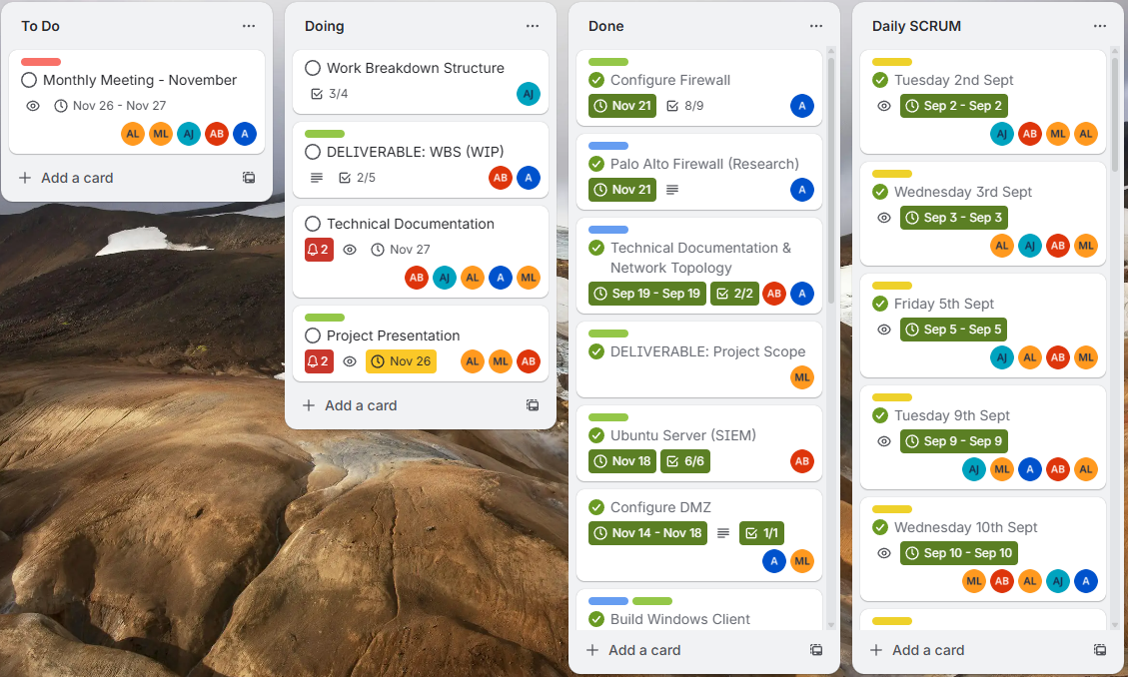

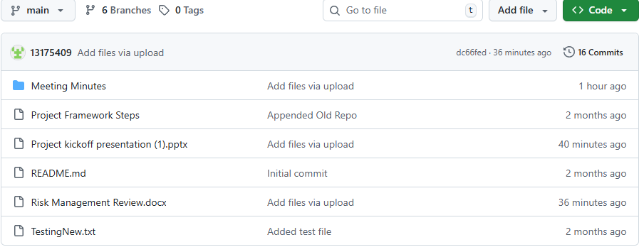
Tools we used for Collaboration:
Discord: We communicated outside of the classroom through a discord server where we talked about what every individual person was going to do and if we had any problems we could talk through there.
Git Hub: This is our main source of files where all our drafts, captures and final parts could go with our own personal branches and a main one for everyone to submit the final parts.
Google Drive: Was used so we could collaborate on staring off the project, our risk management page, the technical documentation and this very presentation.
Trello Board: Our to do list with everything we could need for this project and once we had completed and uploaded the final file we check it off the list.
Anthony

Slide 5



Budget and Risk Management
Budget: After reviewing the project with our stakeholders, we agreed on a budget of $75,000 and allocates $38,300 for all team members wages, with the rest of the allocation spent on our server, switch, monitor, cabling case and firewall coming to a total of $62,016.38 keeping us well withing the budget.
Risk Management: The whole plan for our team (Team Seven) outlines the identification, analysis and treatment of all risk related to the project execution, expressing communication, data integrity and what our compliance to the tasks is. Continued monitoring and constant proactive adjustments aim to make sure our risk mitigation is effective and align with the project scope.
Anthony

Slide 6
Project Documentation & Meetings Overview
Research:
Conducted market analysis for cost projections.
Reviewed other previous project budgets that meant the same requirements as ours.
Engaged our stakeholders for their input on the potential budget allocations.
Meeting Minutes:
Performed and tracked Daily, Weekly, and Monthly meeting minutes to discuss where we were headed, how we were tracking and improvements we could make to improve efficiency.
Documented all key discussions and action points and dates we wanted tasks completed by.
Reflections & Crititques:
Strengths: We had clear set goals and involvement from all team members.
Improvments: More focused discussions to minimisie any confusion on what tasks needed to be completed
Performance Impact: - Improved focus on key issues could have lead to quicker decision-making and troubleshooting. - Better daily attendance from all members.
Michael

Slide 7
Project Management Execution Review
Role Fulfillemnt:
Everyone met their designated roles during the completetion of this project.
Challenged Faced:
Communication and class attendance was our biggest setback and continuously lead to mis communication and days where we had no idea where we were up too as a group.
Deadlines were not exactly met as we underestimated how long the tasks for this project would actaully take, along with our mis communication.
Improvement Opportunities:
More active communicaion between all members of the group.
Better class attendance.
Fix our sleep schedules.
Dont work at maccas til 1am then stay up til 4am scrolling instagram reels.
Michael

Slide 8
Project Execution
Network & Infrastructure Development, Deployment, and Testing

Slide 9
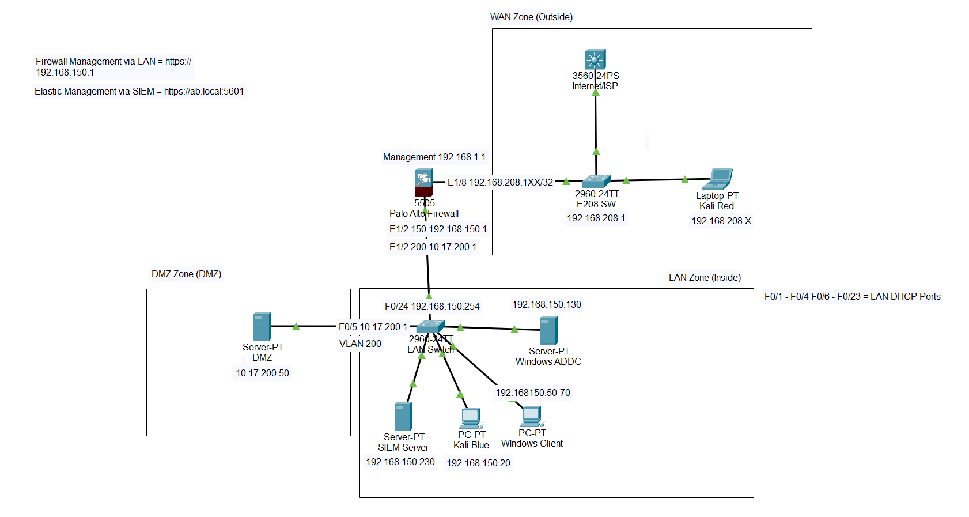
Network Topology & Overview

Slide 10

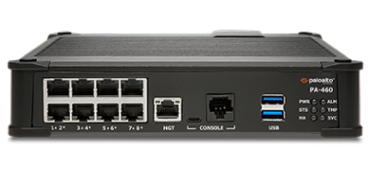

Slide 11

Research & Development
Mapped LAN, DMZ, and WAN networks through packet tracer initially.
Created Ethernet interfaces and Zones on firewall.
Identified required traffic flows on the network.
Designed access rules utilizing least privlige method.
Planned NAT for internet + server access.
Selected core security profiles based on best practice and companies requirements. Reserached into methods of penetration testing using kali and other tools.

Slide 12
Firewall Setup & Testing
Network Segmentation/Zones
Baseline Security Policies (Establishing Internet Connectivity)
DNS Proxy Configuration
DMZ & LAN DHCP Configuration
Device Timezone
Basic Ping Testing

Slide 13

Security Baseline & Considerations
Access Control​
LAN > WAN.​
WAN > DMZ.​
LAN > DMZ.​
​
​
​
Further considerations
Dynamic threat updates.
Comprehensive logging system integrated into SIEM.
Passwords kept simple and memorable for testing purposes.
Threat Prevention
Antivirus
Anti-Spyware
Vulnerability Protection
URL Filtering
Zoned Flood protection
DoS Filtering

Slide 14
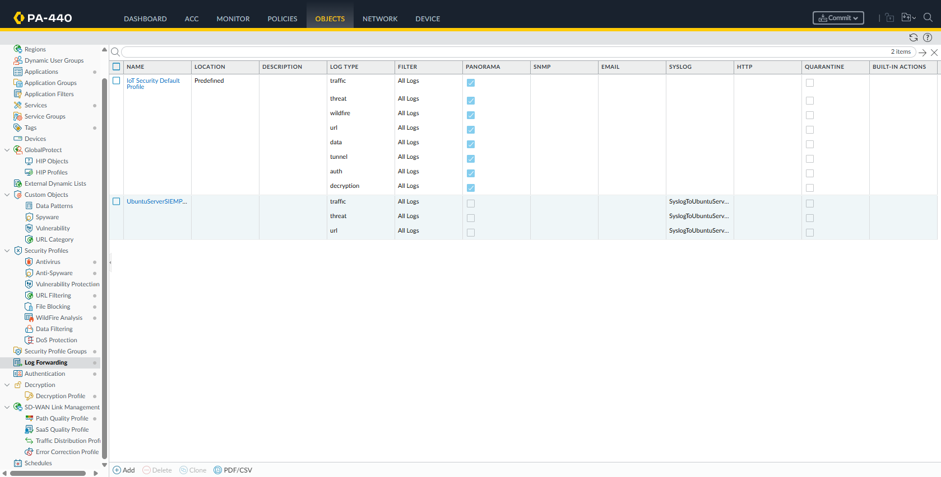
Security Baseline & Considerations

Slide 15
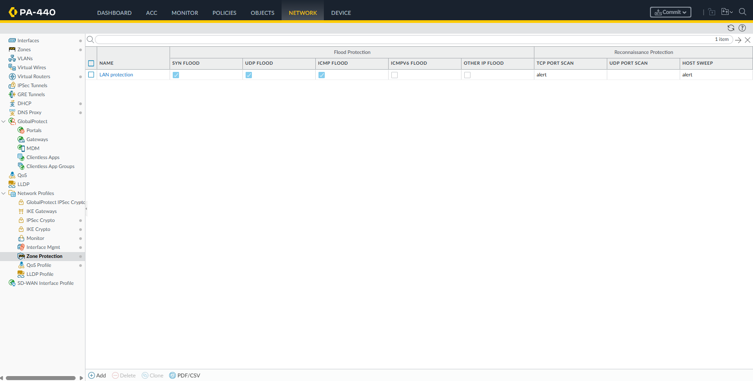
Security Baseline & Considerations

Slide 16
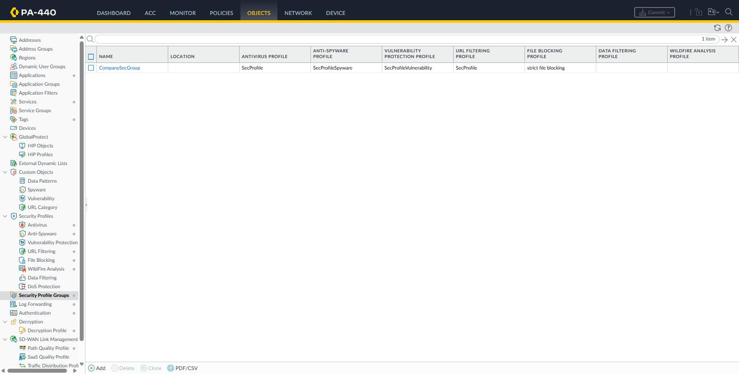
Security Baseline & Considerations

Slide 17
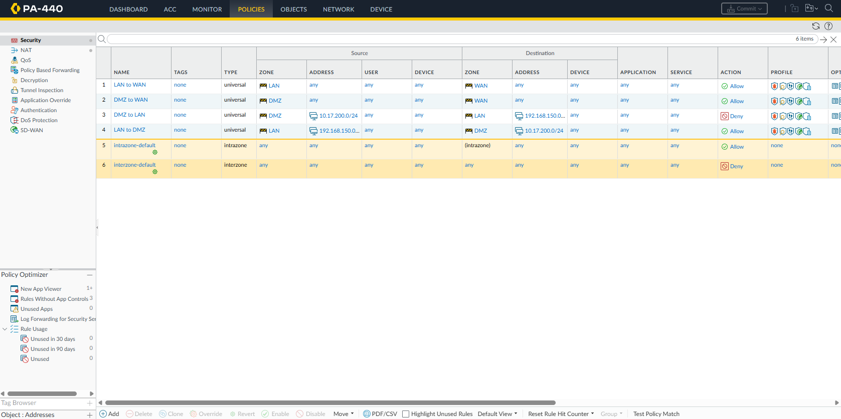
Security Baseline & Considerations

Slide 18

Troubleshooting
Verifying policy actions (Allowing and Blocking.)
Checking if malicious traffic is being dropped by zone protection and security profiles through the monitor page.
Confirming correct reverse path NAT for WAN > DMZ.
Validating firewall routes through the use of ICMP echo pings.
Ensuring firewall was allowing ping connections across the network.
Security profile configurations such as ,the antivirus and file blocker had correct actions like block or drop for malicious connections or files.
Ensuring logs were being forwarded through the use of a forwarding profile and confirming the syslog server was reachable.
Certificate Authority halted for TLS/SSL decryption for viewing files, would recommend using WildFire instead.

Slide 19

Network Switch
Switch Choice
Switch Access
Interface Assignment & Security
VLAN Assignment
Trunking
Additional Considerations

Slide 20


Ubuntu Server (SIEM)
Elastic
Real-time security event correlation
Centralized log retention and compliance
Automated alerting and notifications
Threat detection and analysis
Visual dashboards and reporting
Incident investigation and forensics
User and entity behavior monitoring
Scalable data ingestion and indexing
Kibana

Slide 21
Setup - Testing & Troubleshooting
Finalizing Deployment
Initial Setup and Deployment
Achieving Connectivity
Testing and Troubleshooting

Slide 22

Initial Setup & Deployment
Installing Ubuntu Server
Configure server netplan information
Testing Network & Internet Connectivity
Installing Elastic
Configuring Elastic
Adding Manual SIEM DNS Entry to Firewall
Installing Kibana
Configuring Kibana
Connecting Kibana to Elastic
Kibana FQDN Config

Slide 23
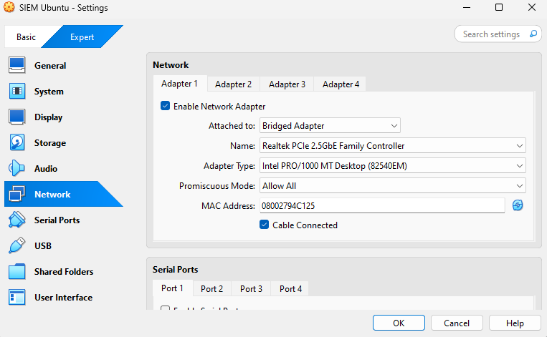
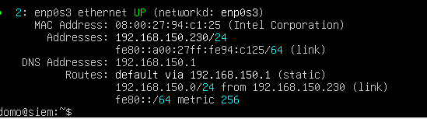
Achieving Connectivity
Netplan Configuration
Ip Address
Subnet
Firewall Troublshooting
DNS Proxy Configuration
Syslog Forwarding
Syslog Service Route
Virtual Box Network Configuration
SIEM Netplan Configuration

Slide 24
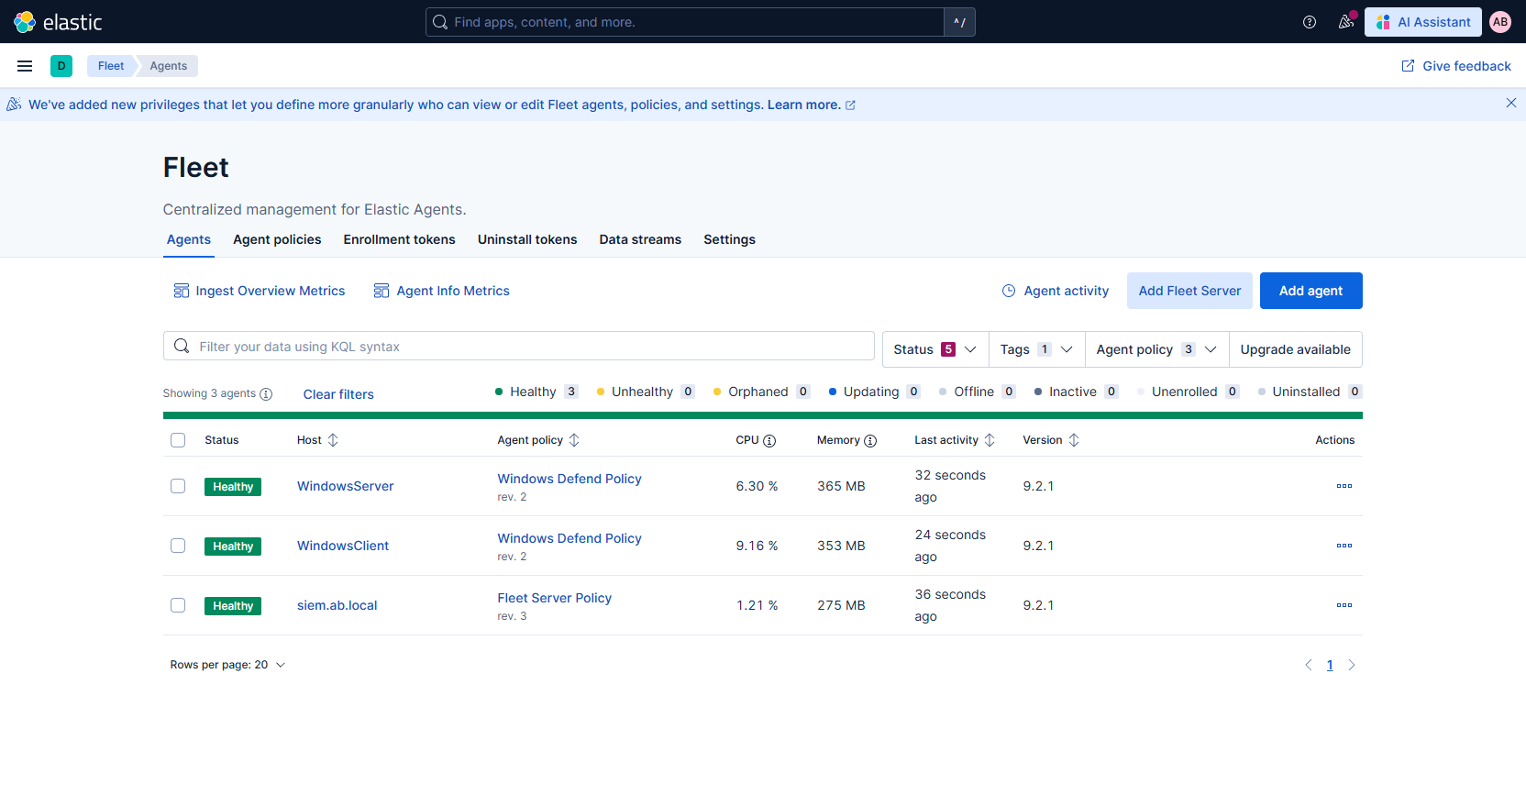
Elastic Agent Integration
Researching viable integrations
Installing Agents
Windows Client
Windows Server
SIEM Server (Firewall Logs)
Troubleshooting
Reinstalling Agents
Deleting Broken Agents
Optimizing Script Structure

Slide 25
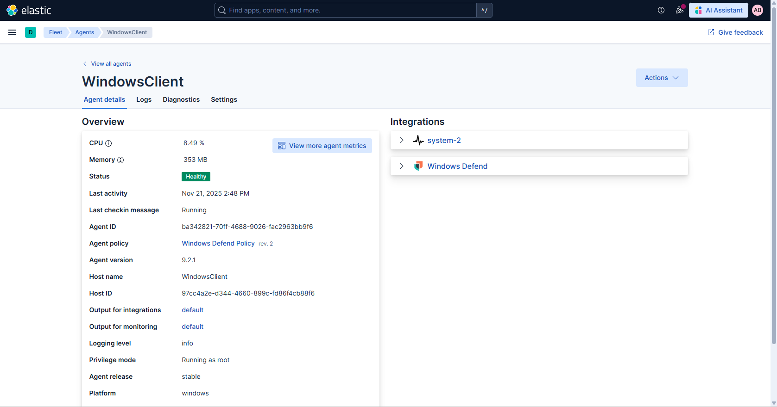
Elastic Agent Integration

Slide 26
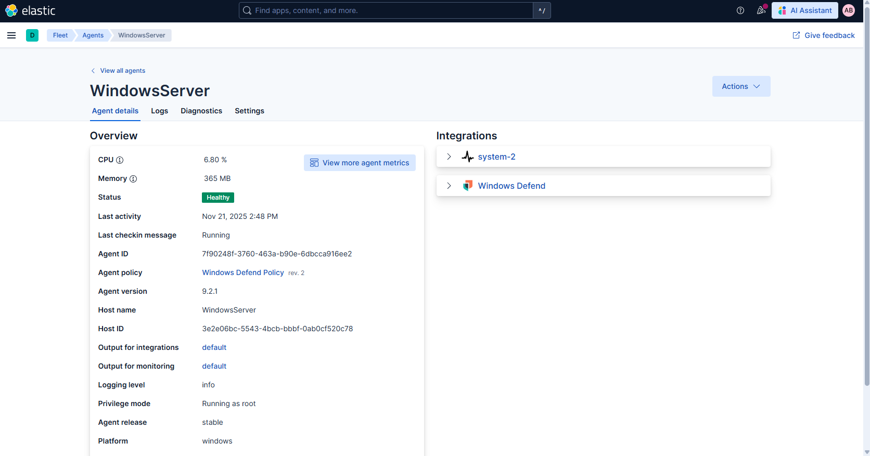
Elastic Agent Integration

Slide 27
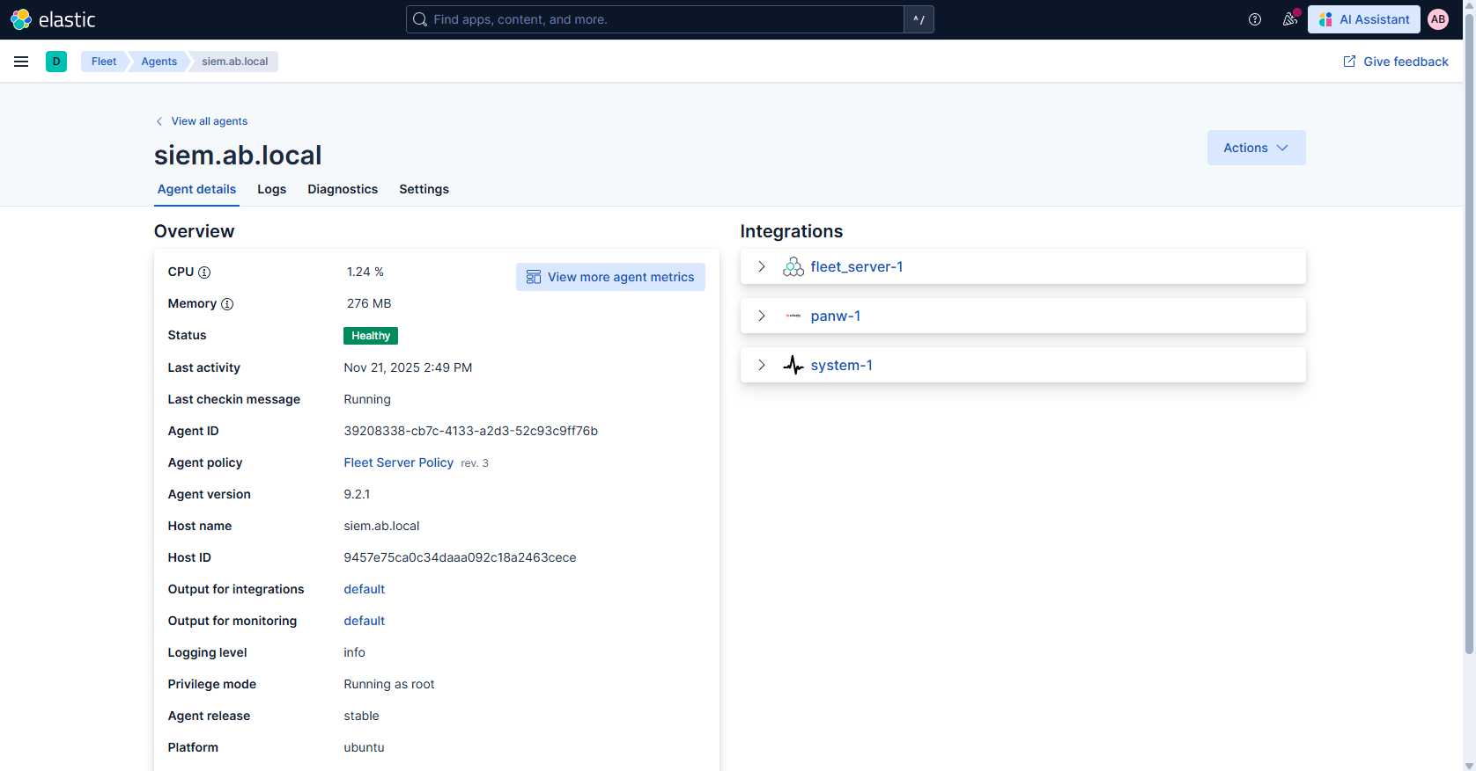
Elastic Agent Integration

Slide 28
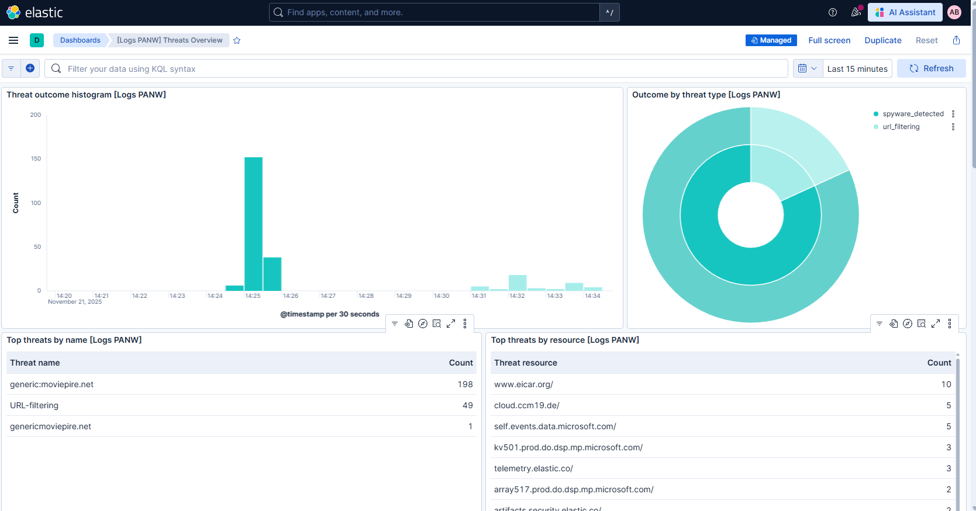
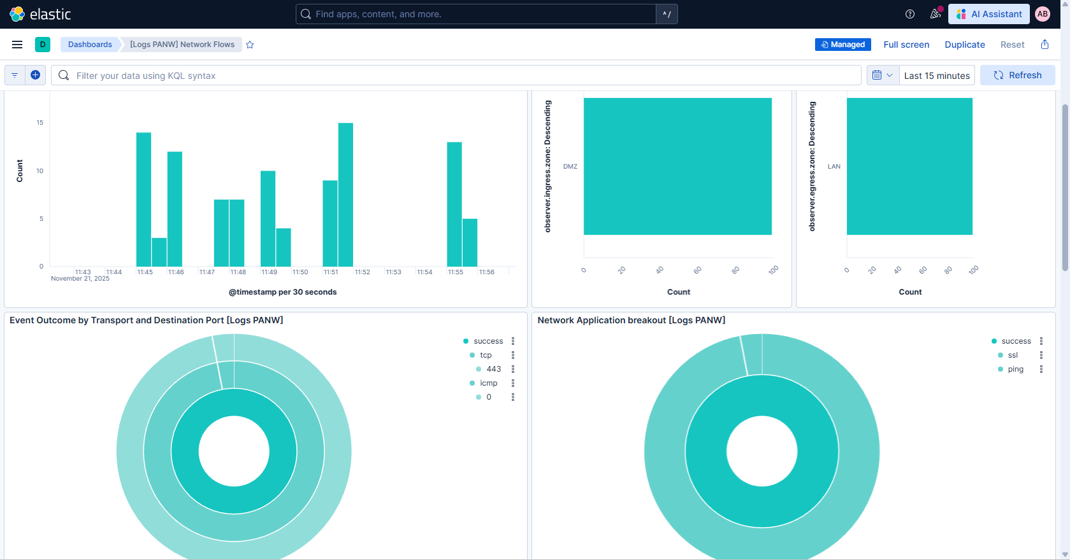
Testing & Troubleshooting
Identifying Causes
Log Integration not working
Unreliable Connectivity
Unraliable Web App Access
Unreliable Threat Logging
Firewall Threat Log Testing
Firewall Traffic Log Testing

Slide 29
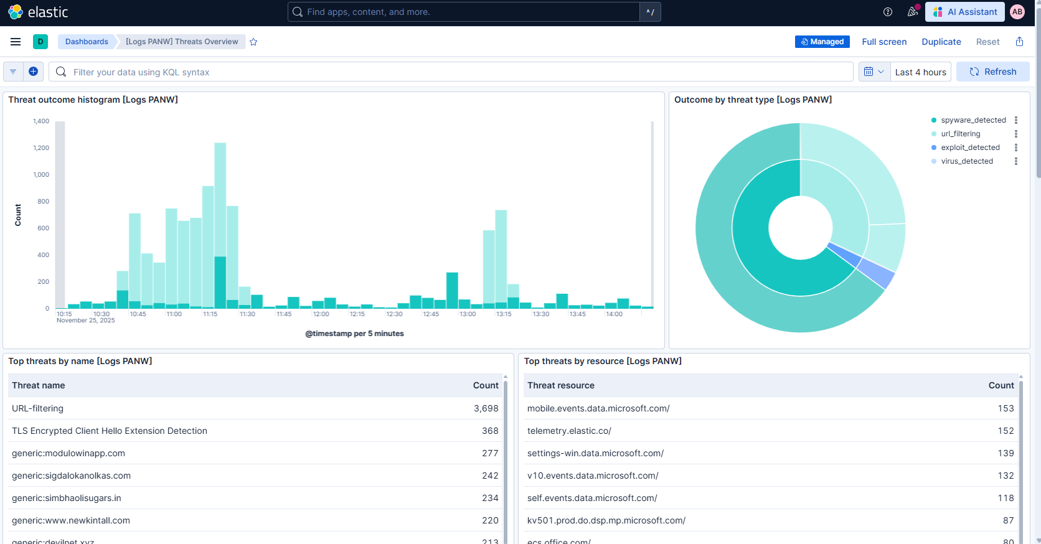
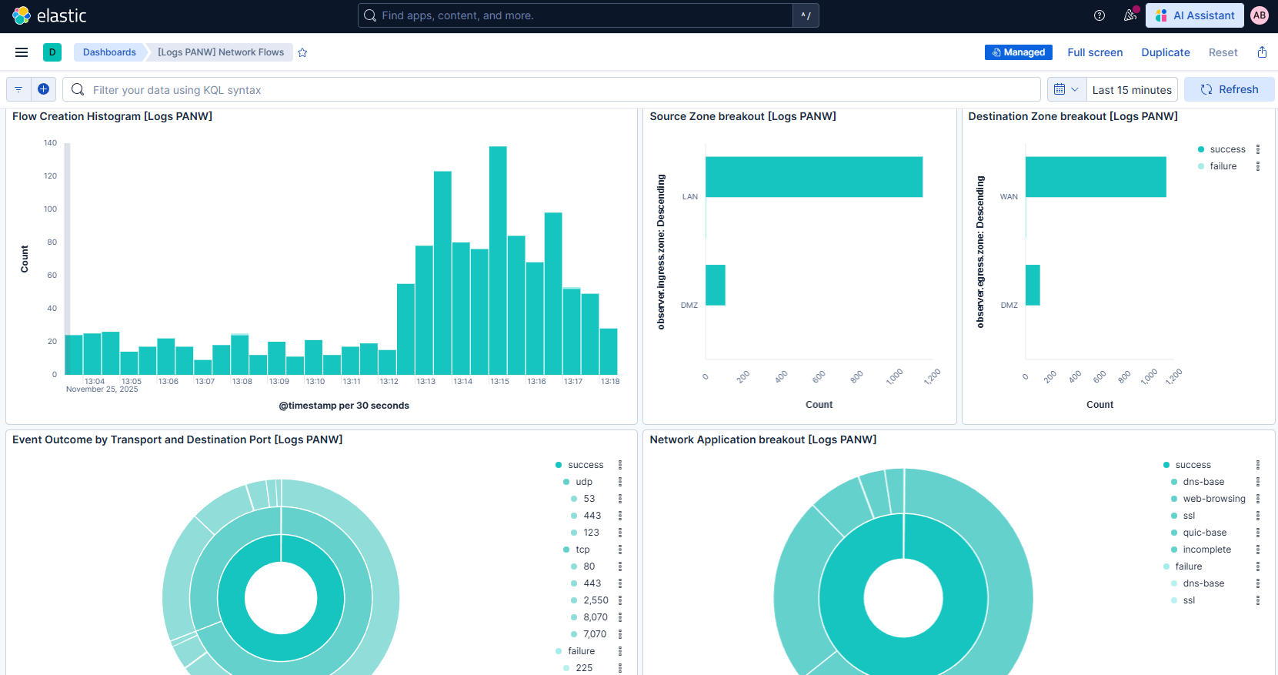
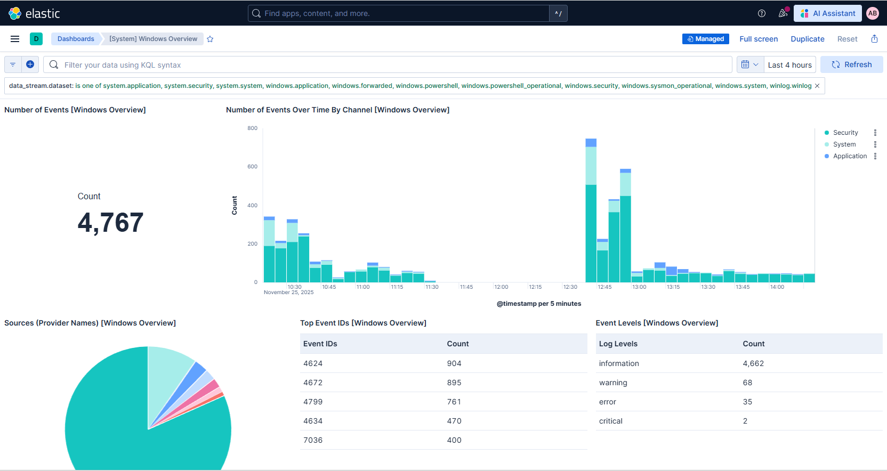
Finalizing Deployment
Testing Log Integration
High Intensity Load Testing
Threat & Traffic Analysis
Network Threat Overview
Network Traffic Overview
Windows Overview

Slide 30
Ubuntu Server (DMZ)
Hosts intentionally vulnerable web applications OWASP Juice Shop and DVWA in a controlled DMZ environment for security testing, training, and vulnerability assessment. The Apache server is isolated from the internal network to safely simulate real-world attack scenarios and support continuous monitoring through the SIEM.

Slide 31
DMZ Troubleshooting & Connectivity Considerations
Worked with Mark to get DMZ services operational.
Verified internal LAN > DMZ connectivity was working as expected.
Confirmed NAT rules for WAN > DMZ access.
Identified and fixed routing / return path issues.
Ensured firewall rules and security was configured correctly.
Tested external access to DMZ server and the web pages to confirm success.

Slide 32
Windows Devices (Client/Server)
LAN Domain for corporate employees
AppLocker rules – endpoint security
Share Files – User Groups
Internal Security Testing

Slide 33
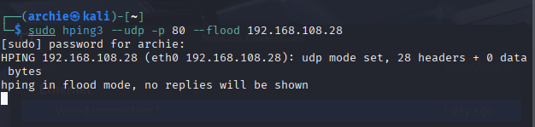

Security Testing and Project Evaluation
Vulnerability & Security Testing
UDP Flood Test
ICMP Flood Test
SYN Flood Test
Malware Download Test
Malicious Website Test
TLS decryption bad.

Slide 34
Dashboard Post Testing

Slide 35
Considered Additions
VPN
Radius
Wildfire
Windows domain configuration
share folders
users, group, OU's

Slide 36
Conclusion To conclude the project, our Cybersecurity Security Operations Center (CSOC) Project was a success as we; - Constructed a network for a Small, Medium Enterprise.
Created a github for group file submissions as well as a trello board for time management.
Mapped out network diagram in cisco packet tracer.
Mapped out best option for firewall configurations and for company expectation.
Identified risks and how we can work to manage them as we moved through the project.
Configured mikrotik switch access.
Configured working DMZ with access to two landing pages. (Thanks Mark.)
Created SIEM configuration for firewall logs and analysis.
Created a budget

